Slide 1
Course Introduction
Prof. Dr. Dirk Riehle
Friedrich-Alexander University Erlangen-Nürnberg
ADAP A01
Licensed under CC BY 4.0 International
Notes:
It is Friedrich-Alexander University Erlangen-Nürnberg – FAU, in short.
Corporate identity wants us to say “Friedrich-Alexander University”.

Slide 2
Course Learning Goals
To acquire competence in ...
  domain-independent
  principles and practices of
  advanced object-oriented
  design and programming

Slide 3
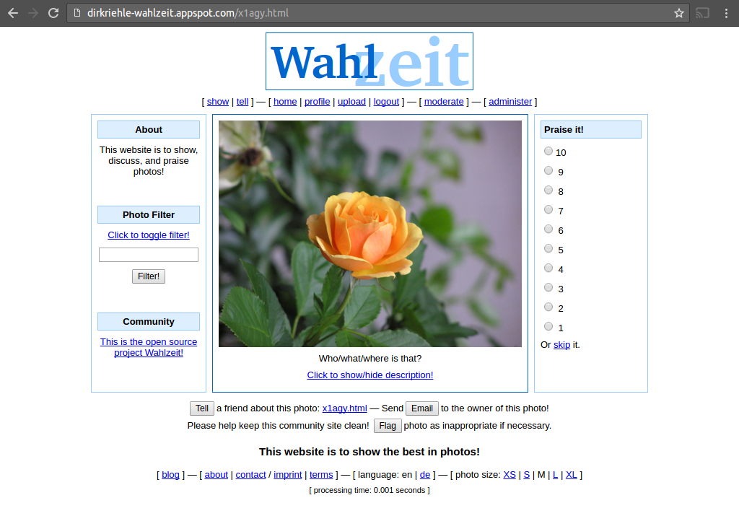
Wahlzeit / Flowers Application

Slide 4

Student Choice of Project 1 / 2
[1] Photo courtesy of Wikipedia with various CC licenses

Slide 5
Student Choice of Project 2 / 2
Choose something that will provide you with domain classes
  Food → Type of food, price, location
  Landscapes → Location, season, camera
  Postage stamps → Stamp, country, age
You will need these domain classes for your homework

Slide 6
Skills Required for Course
Required prior student skills
  Programming in Java
  Working with git
Familiar with
  Operating system (default: Linux)
  Command line (default: bash)
Expected of student
  Willingness to learn by themselves
  We will introduce containerization

Slide 7
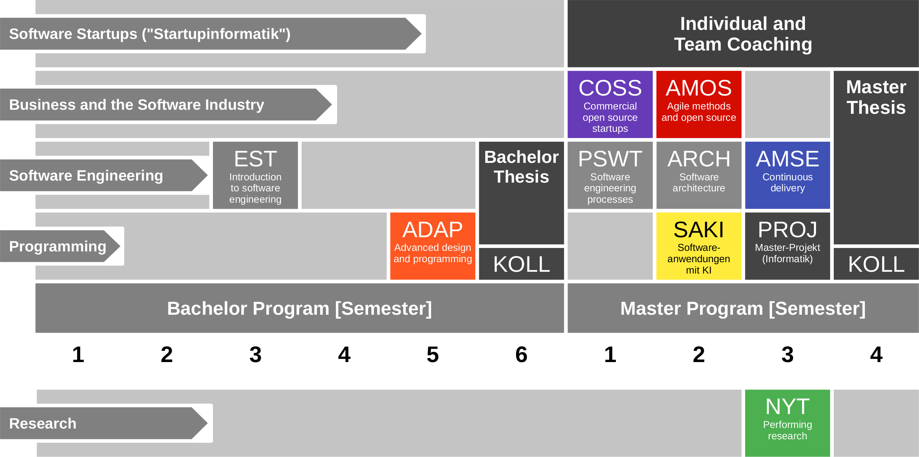
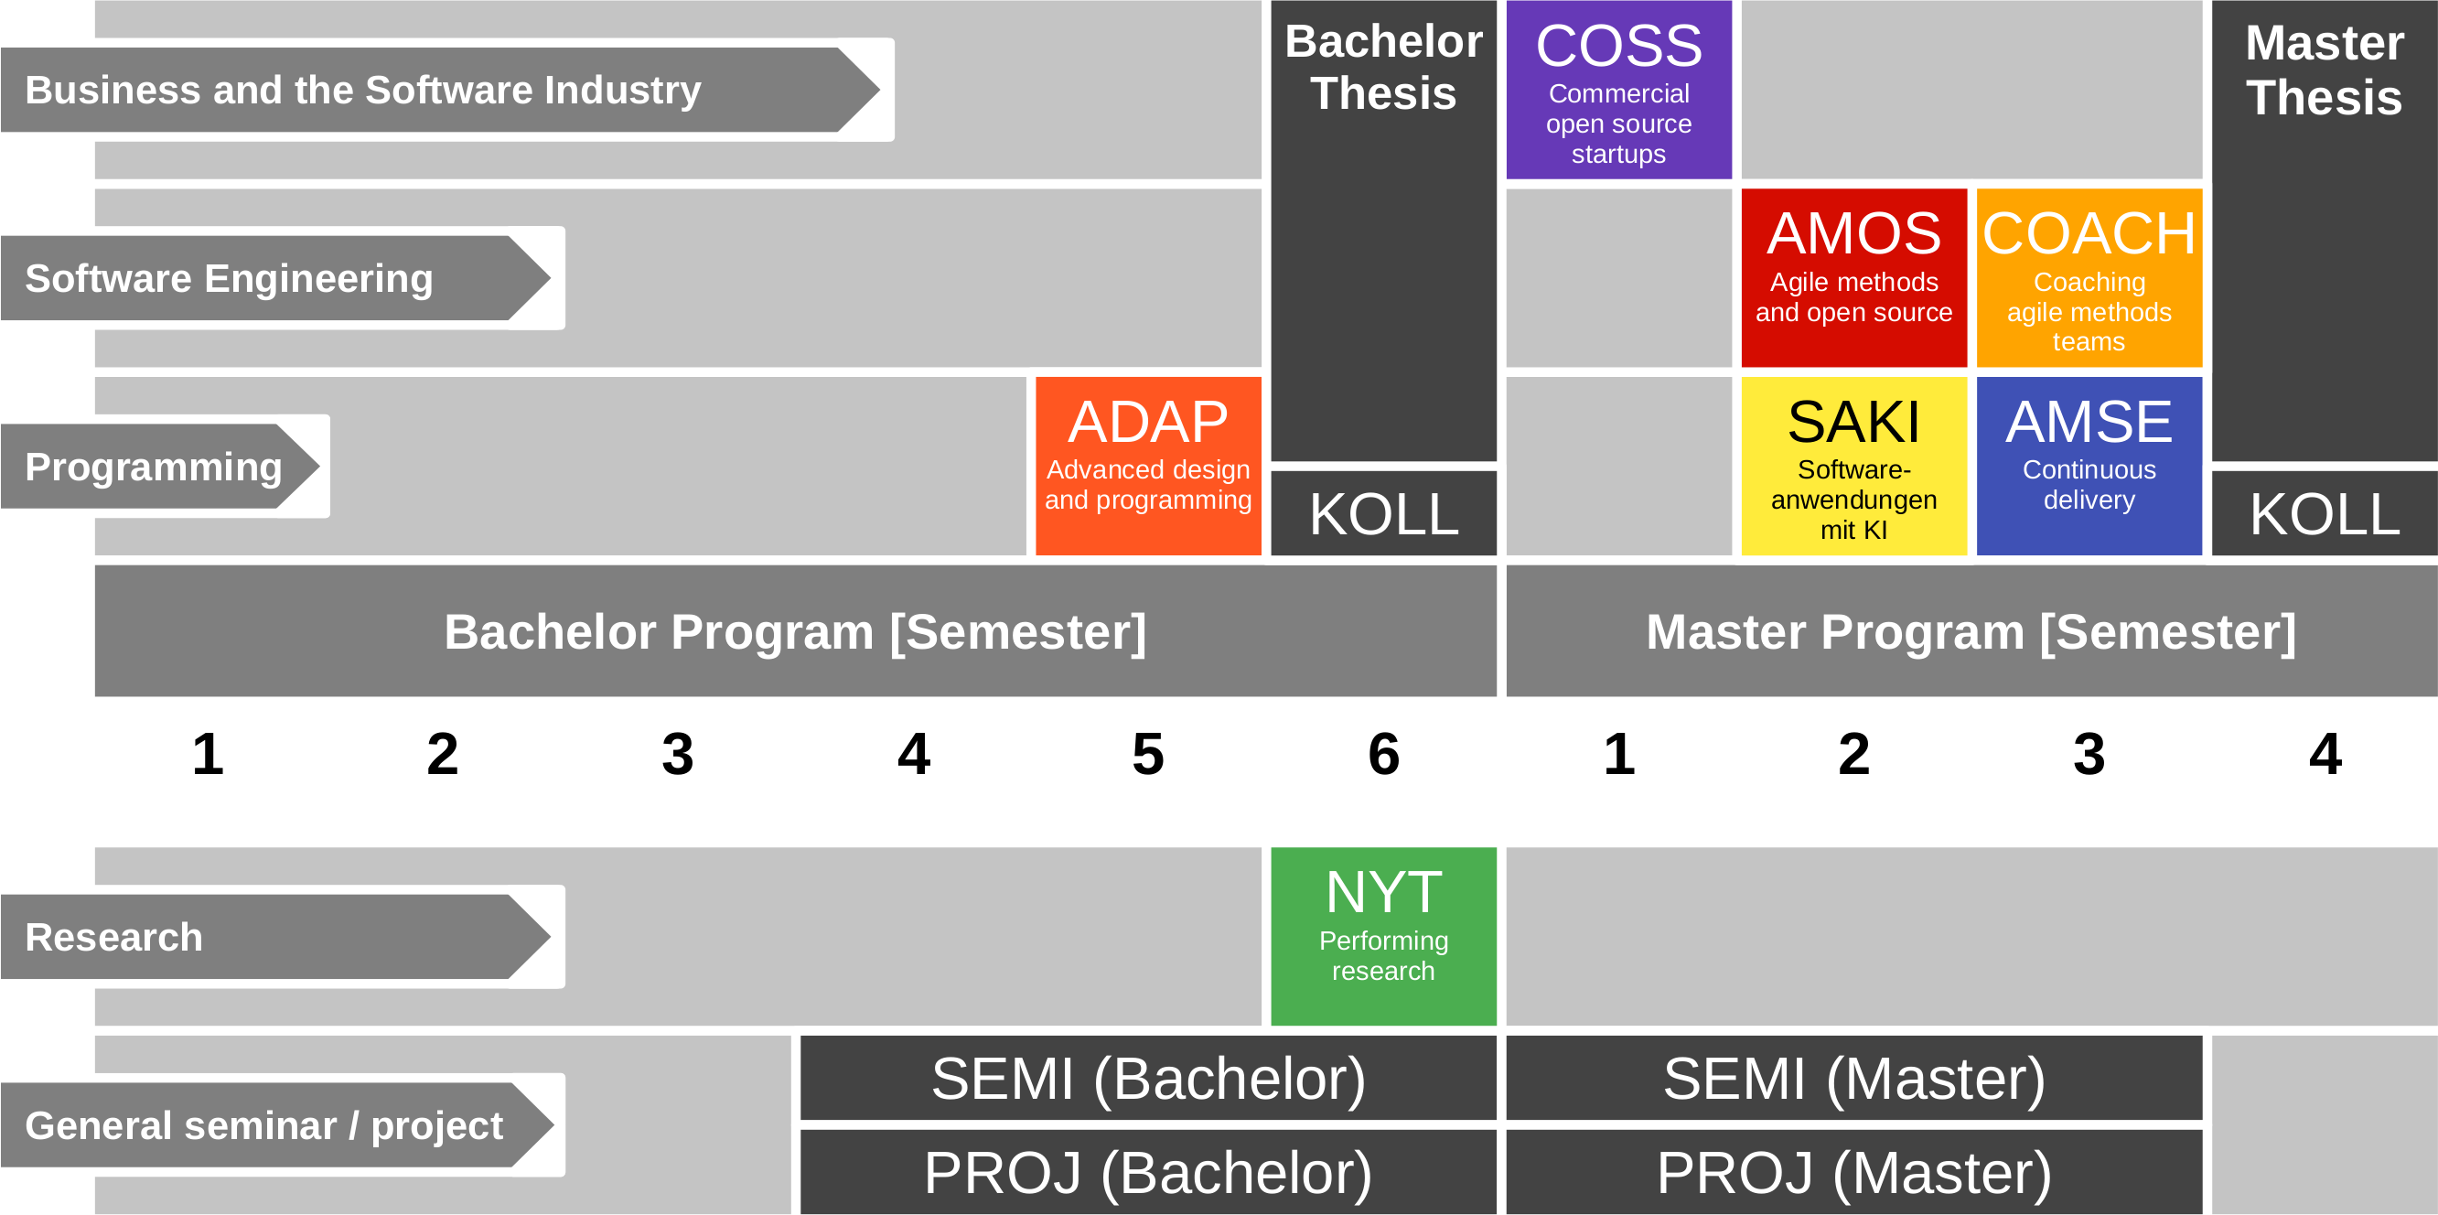
Course Position in Curriculum

Slide 8
Courses and Modules
 |  | Courses (Lehrveranstaltungen)
 |  | OSS-ADAP-VUE |  | Total ECTS
Modules | OSS-ADAP | x |  | 5
VUE = Lecture + exercise (Vorlesung + Übung)
PROJ = Project

Slide 9
Course Grading [1]
Semester contributions = 50% of total grade
  Understanding of lecture content (2 SWS) = 30 / 150 = 20%
    Graded using [0..10] each class session using StudOn quizzes
  Homework assignments = 120 / 150 = 80%
    Graded using [0..10] each
  Active class participation is not graded
    But participation moderates grade if unclear
Oral exam = 50% of total grade
  If both you and we agree on not having an oral exam, it can be dropped
    If there are questions about a student’s performance, we will not drop the oral exam
    If the oral exam is dropped, the semester contributions become 100% of the grade
    If you insist on an oral exam, please tell us within two weeks after the last session
[1] Also see http://osr.cs.fau.de/teaching/course-resources/grading-schemes-and-scales/

Slide 10
Class Quizzes
Each class session starts with a class quiz
  A quiz will test your understanding of last session’s lecture(s)
  A quiz typically has 5 questions and will last 10 minutes
  The overall quiz is graded using [0..10] scheme (10 points in total)
A class quiz will open precisely when class starts
  The quiz is administered automatically through StudOn
  It is your job to have reliable Internet access etc.
  There is no way to make up for a missed quiz
Please see the StudOn quiz FAQ https://bit.ly/2JpgjnQ

Slide 11
Homework Grading
Categories | Points |  |  |  |  | Criteria
 | Disagree | Disagree some | Neutral | Agree some | Agree
Form (10%) | Does the deliverable meet formal requirements? |  |  |  |  | Does the deliverable meet page length requirements, has the right language, has required header, etc.?
Language (10%) | Is the language clear, concise, and helpful? |  |  |  |  | Are sentences complete, is the grammar correct, are statements coherent, etc.?
Solution Design (30%) | Does the solution make sense and is it explained well? |  |  |  |  | Is the answer clear, is it explained why it was chosen, are pros and cons weighed, etc.
Solution Imple-mentation (50%) | Has the solution been implemented well? (If no implementation was required, use your explanation points for the implementation as well.) |  |  |  |  | Is the code clean, follows coding guidelines, is well tested, matches explanation, etc.?

Slide 12
Receiving a Grade for the Course
If you want to receive a grade
  You must register through the course registration system during the registration period
    Course registration → https://campus.fau.de
  Course registration is different from course management
    Course management → https://studon.fau.de
If you cannot register through the course registration system
  Please follow the instructions at https://wp.me/PDU66-2bx
Otherwise: No grade

Slide 13

No Oral or Written Exam [1]
[1] You still have to register for the course

Slide 14
Course Language [1]
Class
  Lecturer: German
  Student: Choice of German or English
Homework
  Source code: English
  Submissions: Choice of German or English
[1] See http://osr.cs.fau.de/2012/03/10/english-or-german-deutsch-oder-englisch/

Slide 15

Course Communication
Announcements by email (through course management system)
Please ask your questions using the FSI Forum for this course
For email, use the teaching team alias from the Course Organization doc

Slide 16
Project Contributor Agreement
For contributions to Wahlzeit, we require a rights grant
  We use the Sun Contributor Agreement
    Available here: http://osr.cs.fau.de/teaching/contributor-agreement/

Slide 17
Course Information
See Course Organization doc at https://oss.cs.fau.de/oss-adap-course

Slide 18
Thank you! Questions?
dirk.riehle@fau.de – https://oss.cs.fau.de
dirk@riehle.org – https://dirkriehle.com – @dirkriehle
DR

Slide 19
Legal Notices
License
  Licensed under the CC BY 4.0 International License
Copyright
  © 2012-2021 Dirk Riehle, some rights reserved

